Slide 1

CEIS150 Final Course Project
Leo Gatlin

Slide 2

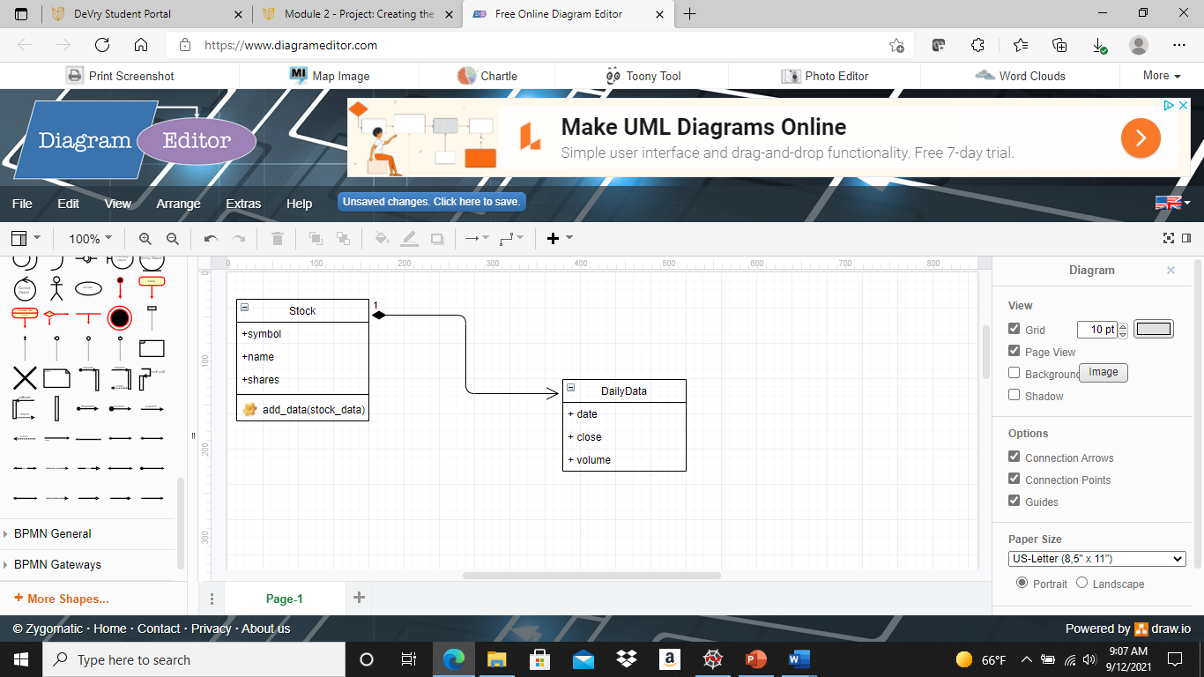
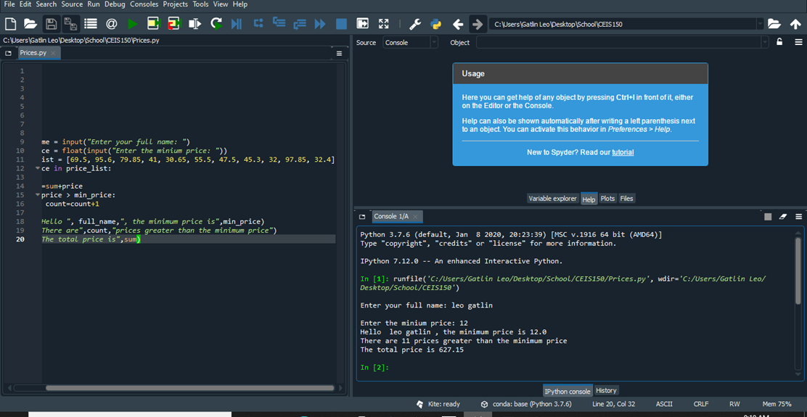
Week 1 & 2
During week 2 we began to understand Class coding and making a diagram that will help with coding and taking those codes and testing them to make sure they are working properly. We also ensured that we properly set up our environment using SPYDER. I had no problems during this week everything went smoothly.

Slide 3
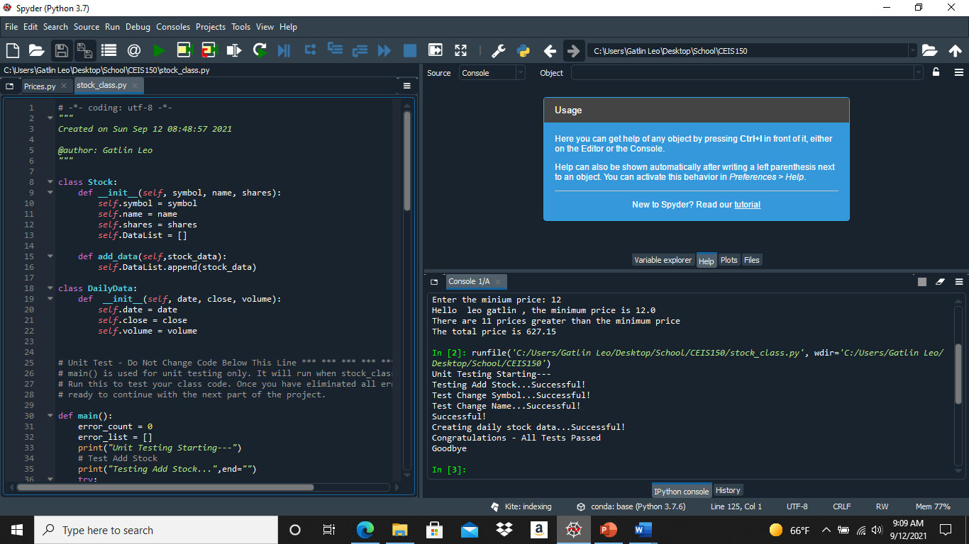
Week 1 & 2 Cont.
As you can see in the pictures below it is my Class code and my testing of the said code to make sure it was running correctly. All codes used were correct with no errors. All were saved under a Stock_Class.py file.

Slide 4
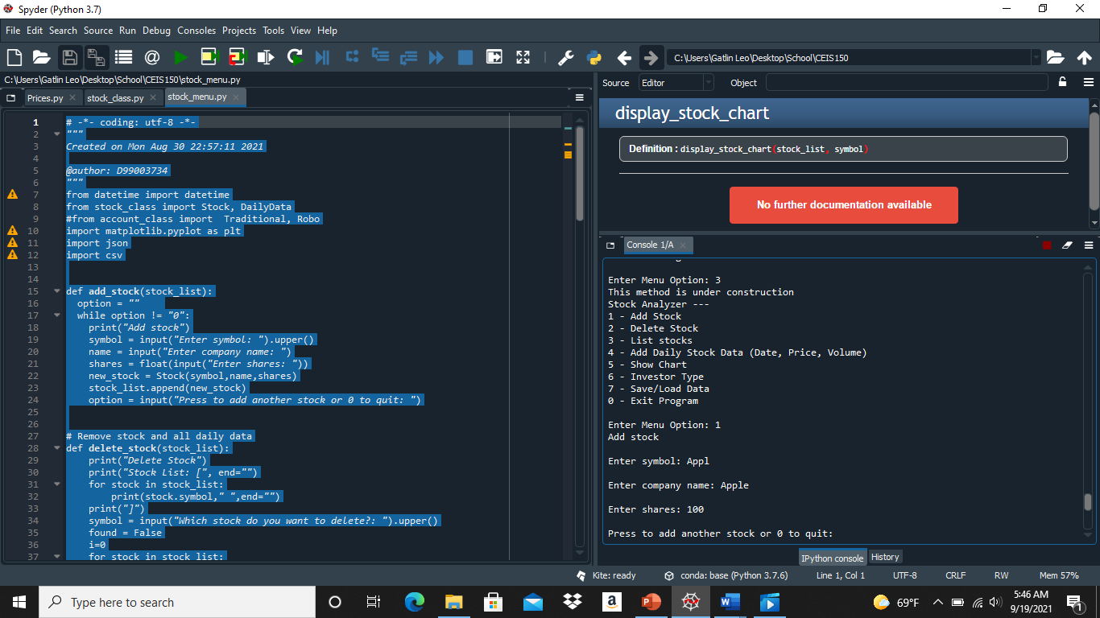
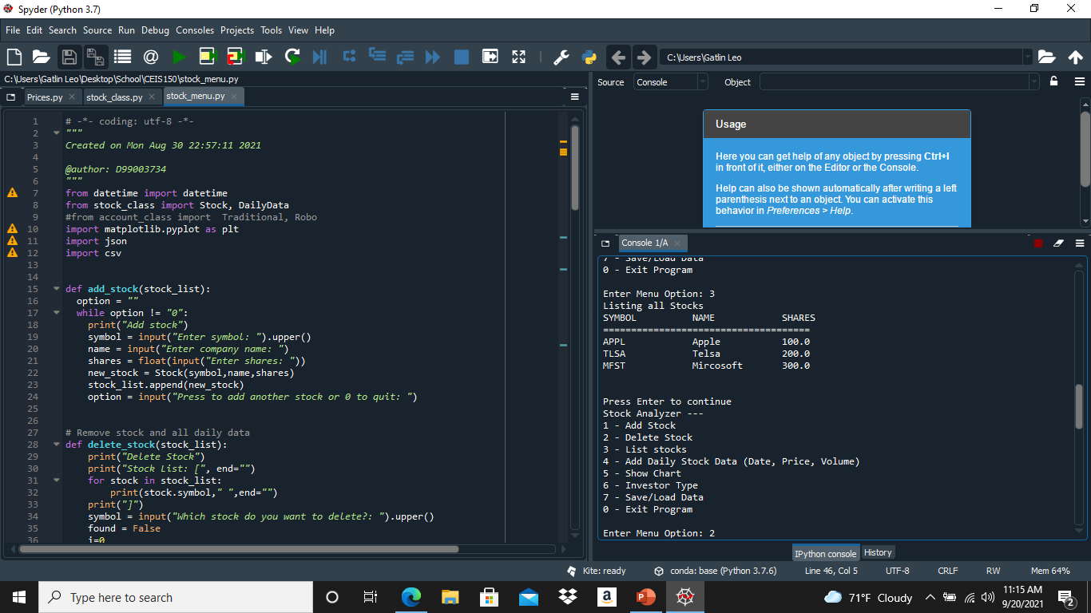
Week 3
During week 3 we began to have a text based interface which will take our code and show it to us in real time which means our inputs will be shown. One of the first thing I had to do was add a Stock if it worked I had to add more as it would be needed for any necessary steps heading forward. They were no issues during this week.

Slide 5
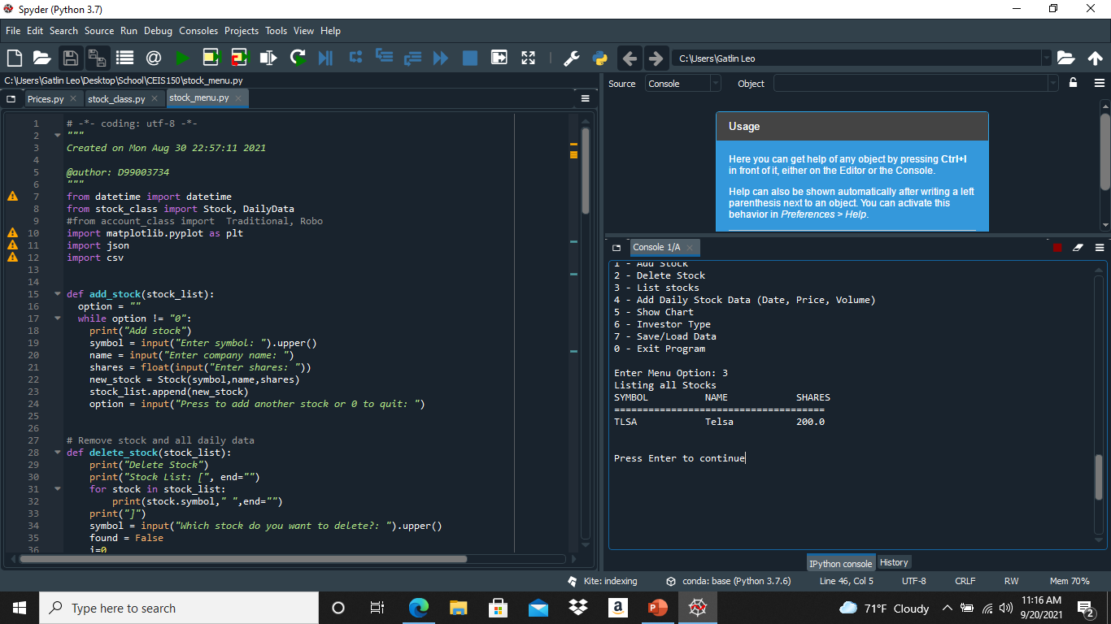
Week 3 Cont.
After the three stock were added it was time to show them in daily data. The main issue I had with this week were I was getting indent errors after looking at the errors a quick fix to them solved all the issues that were present. Shown in the daily data from my inputs.

Slide 6
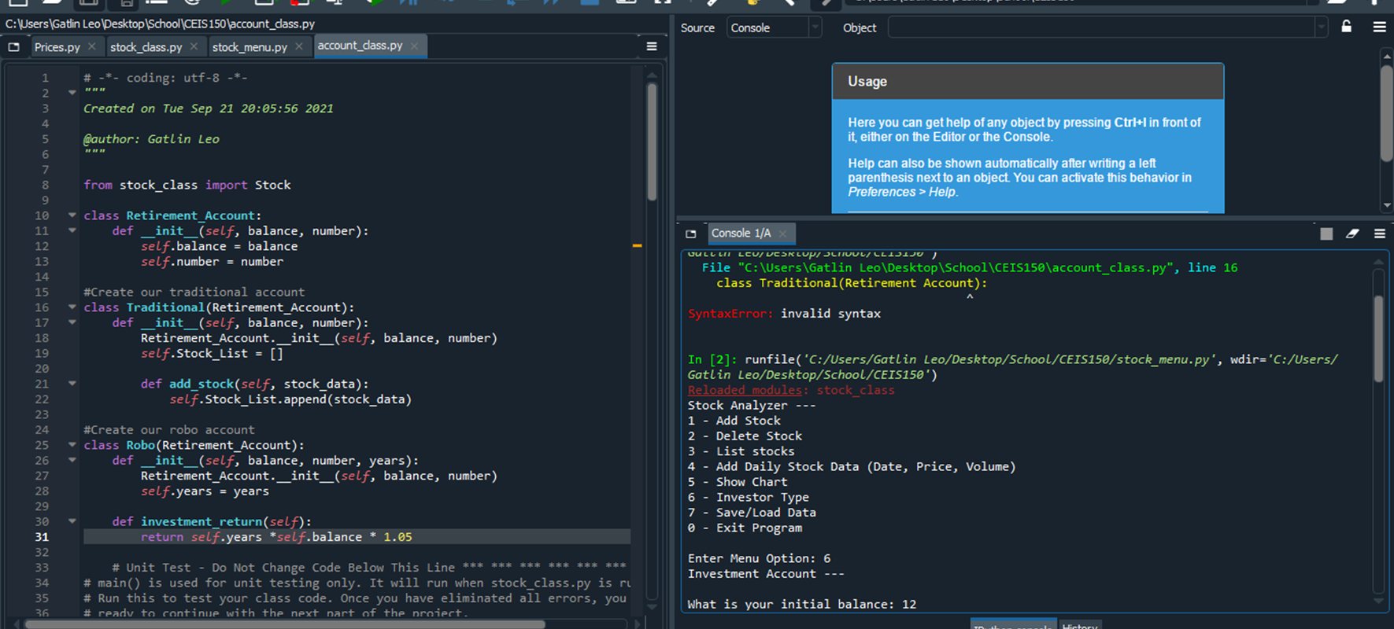
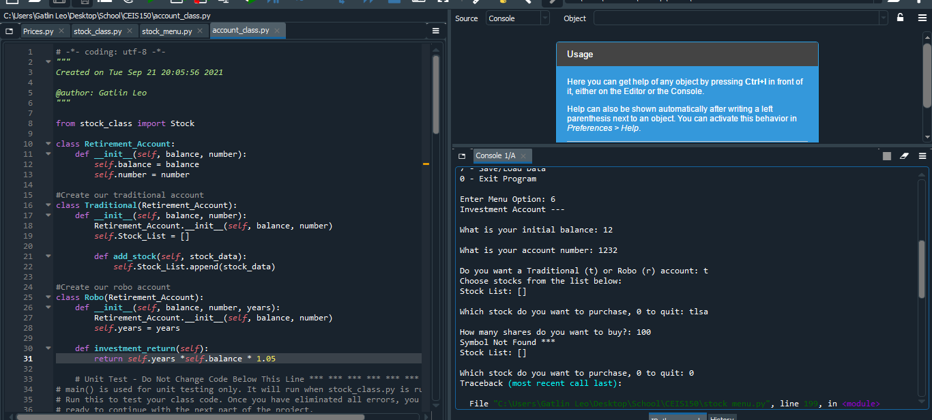
Week 4
During this week it was a focus on Inherited classes which would take a class and is able to inherited from another class without the need to code long strings of data. After it was completed I needed to run the Unit Tests and show screen shots of my working main program.

Slide 7
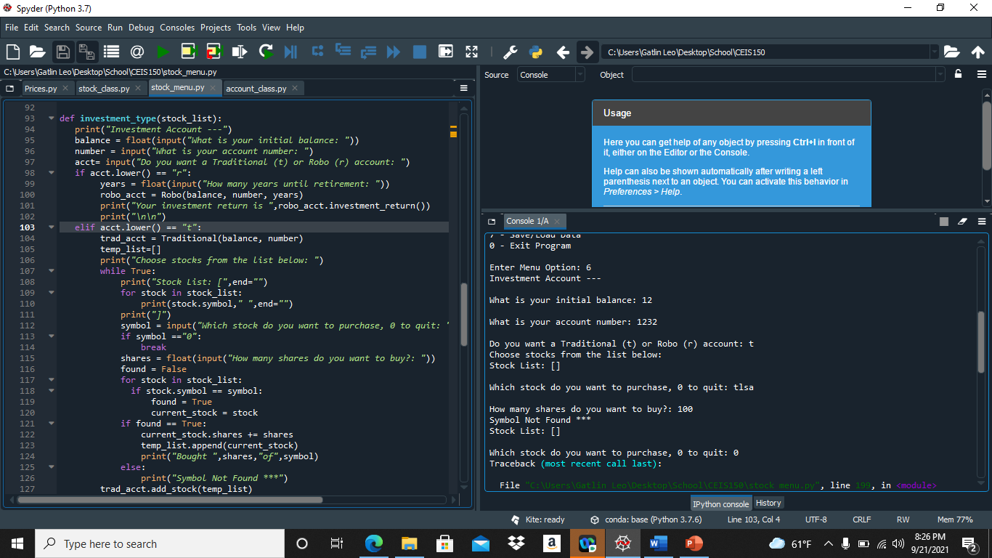
Week 4 Cont.
Shown is a updated Stock Menu showing not only my listed stock but showing a balance the program now is slowly, but surely coming together, but not quite done yet. I had no issues beyond indenting issues.

Slide 8
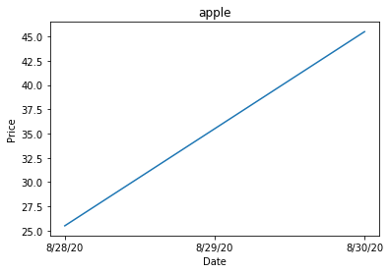
Week 5
During this week I only had to post a screenshot of a Stock I picked on a graph as you can see here it was increasing constantly. The chart came from coding to which I got from coding. I had a issue during this week as something with my chart was working so it wouldn’t show the dates after talking to Dr.Cooper I had shown that I had a small coding error which were a missing line of code once solved it worked again.

Slide 9
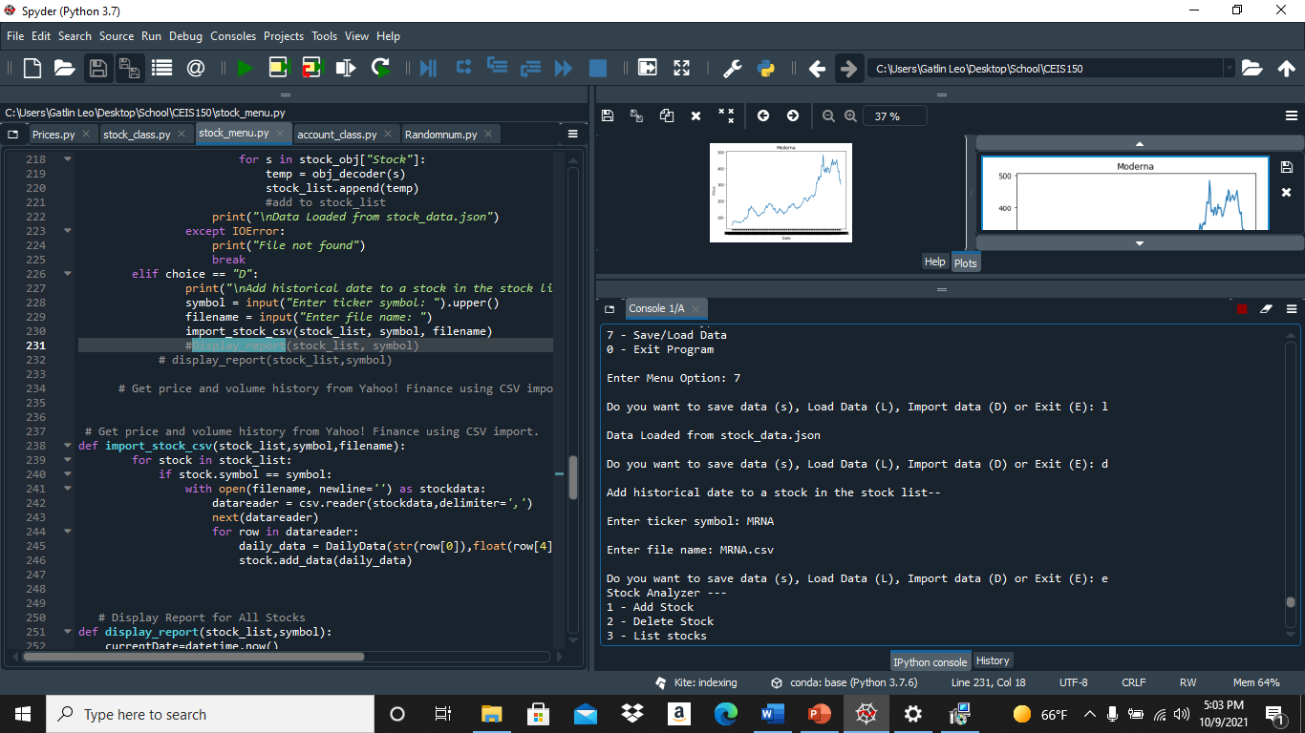
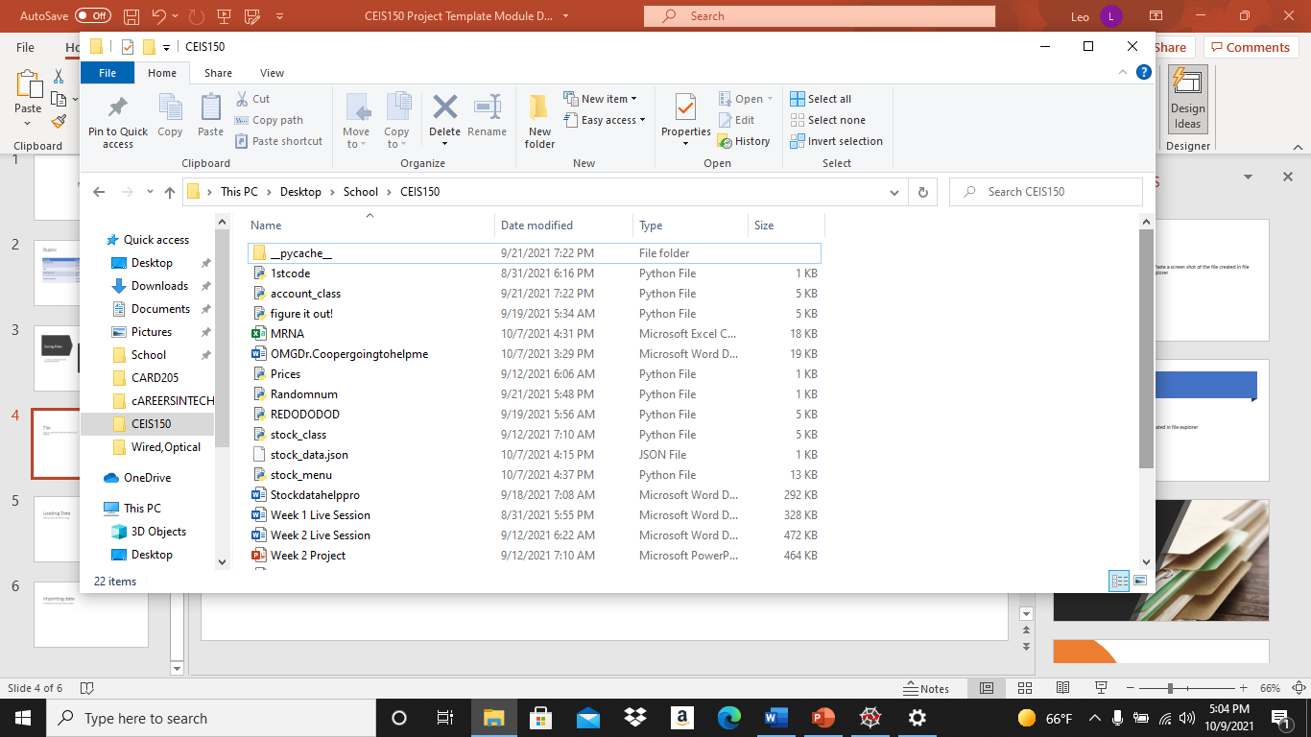
Week 6
During week 6 it was a jam packed week and one of the most of the coding that was done. During this time we were unable to save data, import any data or load data after that would be a thing of the past and I wouldn’t need to keep typing the data repeatedly.

Slide 10
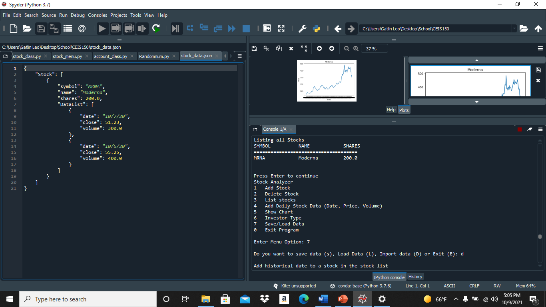
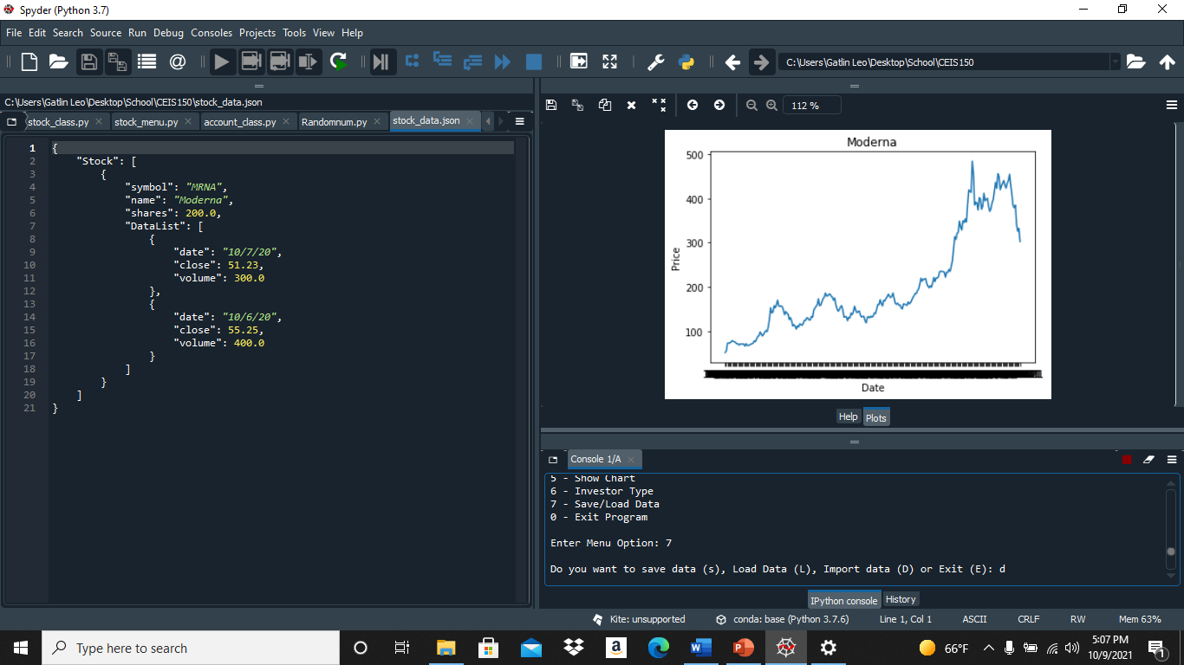
Week 6 Cont.
During this time the stock I picked was MRDA which is Moderna and imported the data from Yahoo Finance as historical data. I had a problem with the graph above working, but after trail and error it worked again.

Slide 11
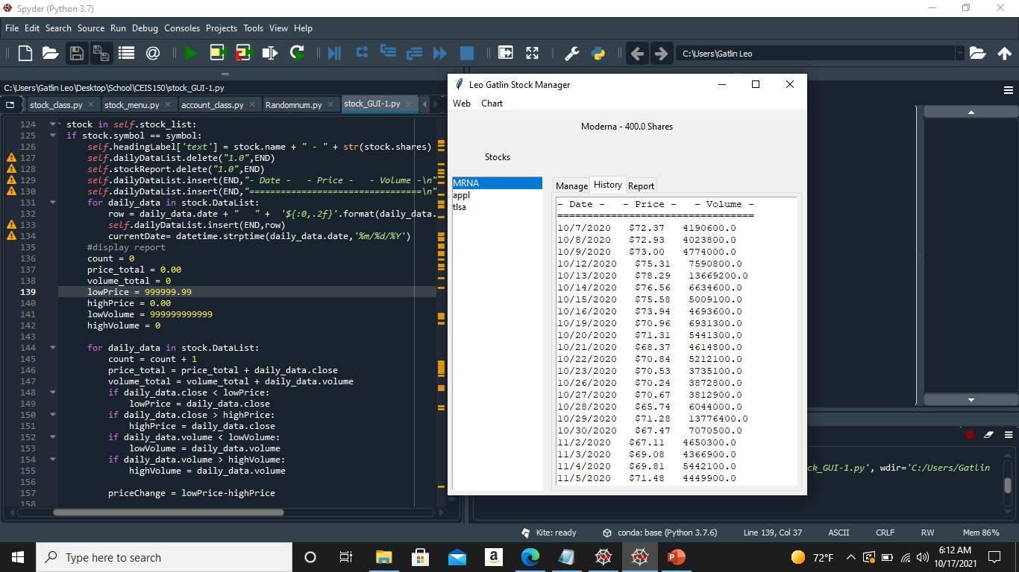
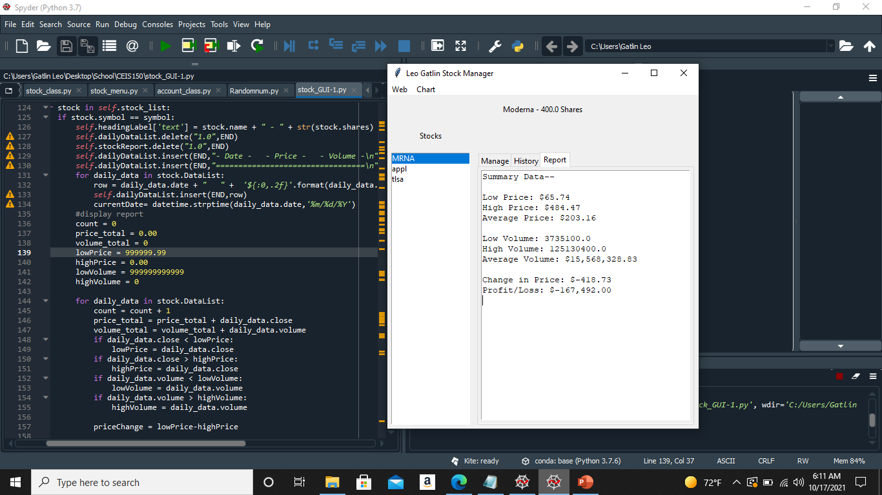
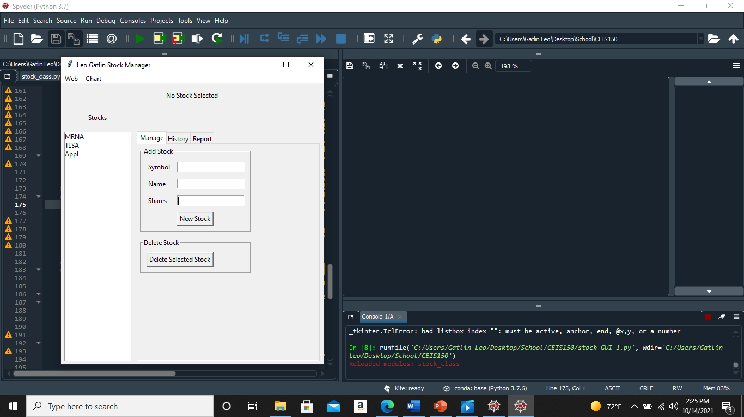
Week 7
During this week it was placing everything into a GUI and it was quite easy we had to show different tabs and it working from the Stock that we picked and showed it based on the data pulled from Yahoo.

Slide 12
Learned
I learned so much doing this course on how inheritances works to pulling live data from Yahoo and using it for my GUI to show my stocks and trends it was a wonderful class which extreme coding and errors could come out of nowhere but with a little work everything was solved.

Slide 13
Thank you!

